Slide 1

HR ANALYTICS
An employee is an asset to the company. They define the future and present of the company. So, it is obvious that a company invest a huge attention, money and care for its employee to make them not leave. People Analytics is simply the way of giving answer to why employee leave the employers through the data.

Slide 2


OBJECTIVE
The aim is to identify the factors which have the most probability for an employee to attrition
To build the best model for the predictions using different technique

Slide 3
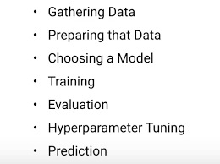
Seven Steps

Slide 4

DATA UNDERSTANDING
INDEPENDENT VARIABLES
Satisfaction level
Average working hours
Number of projects
Promotion
Departments
Salary
DEPENDENT VARIABLE
People Left
TEST SIZE
25%
TRAIN SIZE
75%

Slide 5
EXPLORATORY DATA ANALYSIS
People with high salary are most satisfied.
People from sales background leaves the job most.
There is negative correlation between promotion and the target column.
Average monthly hours of different departments are almost same.

Slide 6
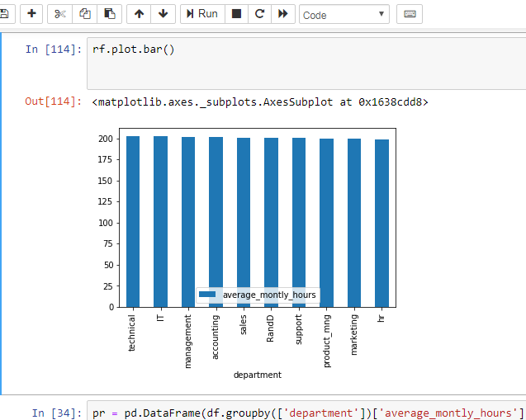

Slide 7
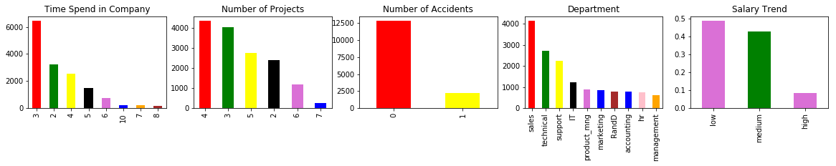
ANALYSIS

Slide 8
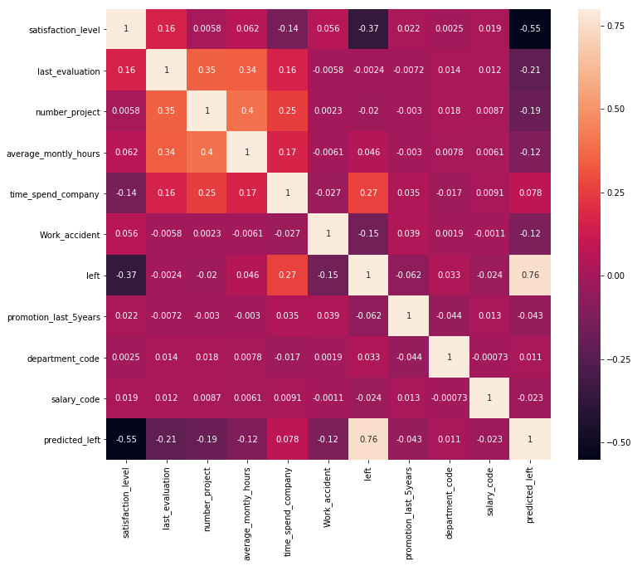
HEAT MAP

Slide 9
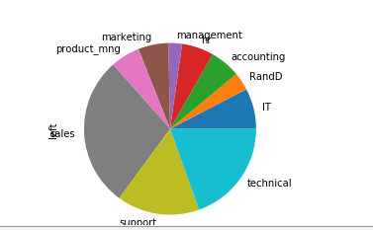
PEOPLE LEAVING THE COMPANY

Slide 10
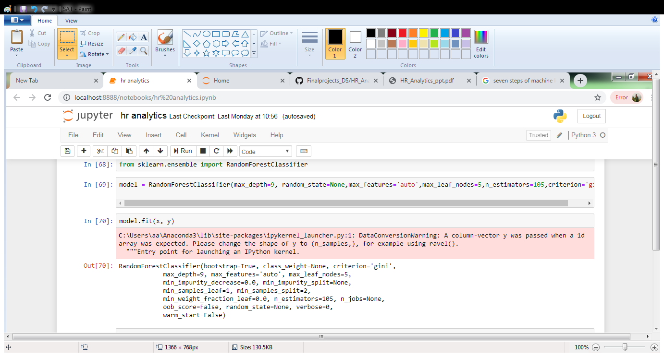

APPLYING MODEL-RANDOM FOREST CLASSIFIER

Slide 11

PARAMETERS
MAX DEPTH= 9
N-estimators=105
Criterion= gini
Max-features= auto
Random state= none

Slide 12
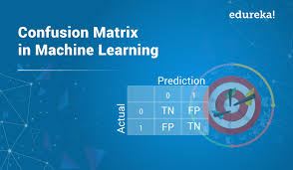
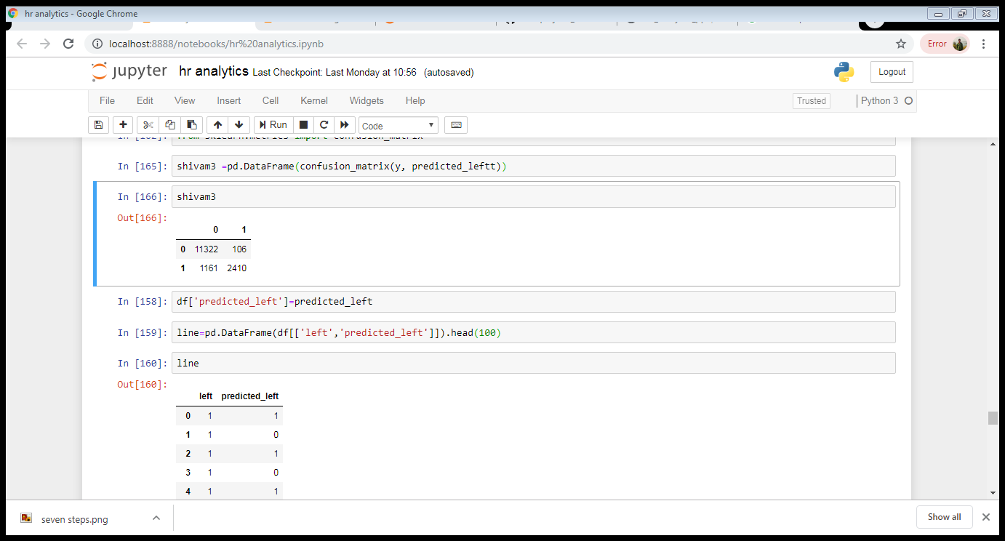
Confusion Matrix

Slide 13

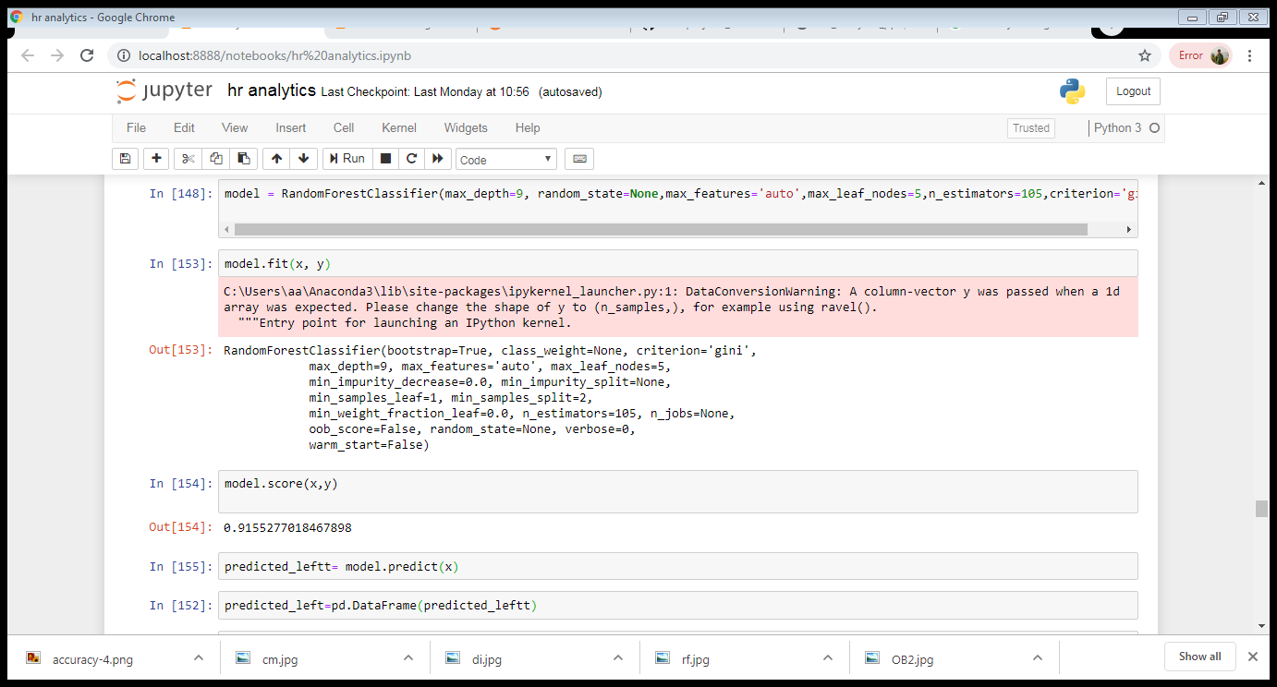
Accuracy Score

Slide 14
SUGGESTION
Company should recognize the employee for its hard work by giving promotion
Number of projects should be minimized in order to reduce the stress level.

Slide 15
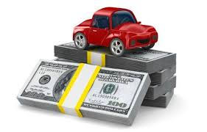
CAR PRICING

Slide 16
OBJECTIVE
To ascertain the prices of the car based on different independent columns by developing linear regression model, under the given dataset there are many categorical data present, we will convert them into numeric form by using one hot encoding or dictionary

Slide 17
DATA UNDERSTANDING
INDEPENDENT VARIABLES
Car body
Aspiration
Fuel type
Door number
Engine location
Drive wheel
Wheel base
Horsepower
Compression ration
DEPENDENT VARIABLES
PRICE
TEST SIZE= 25%
TRAIN SIZE= 75%

Slide 18
EXPLORATORY DATA ANALYSIS
Car with body like HARDTOP and CONVERTIBLE are the costliest ones.
Cars having REAR engine location are having high prices.
Car named Alfa-romero-giulia is having high price.

Slide 19
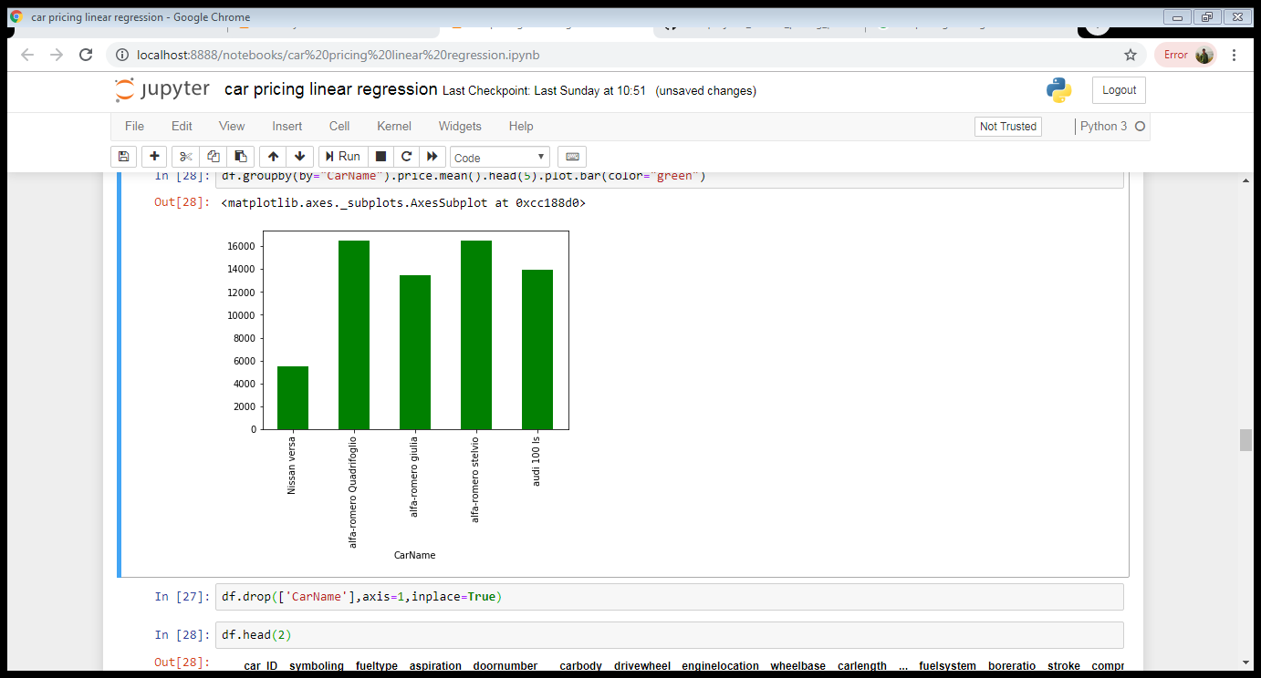
CAR WITH HIGHEST VALUE

Slide 20
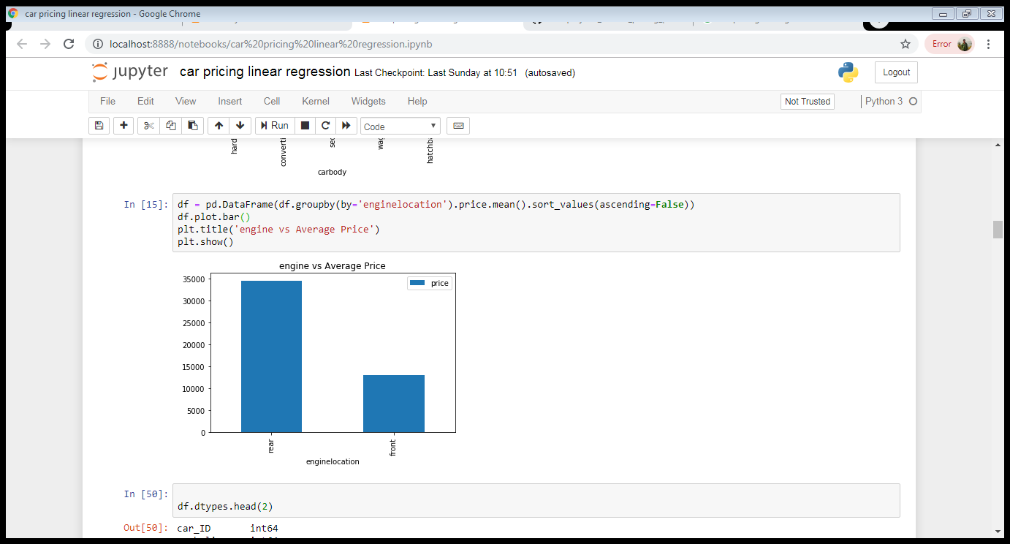
ENGINE LOCATION VS PRICE

Slide 21
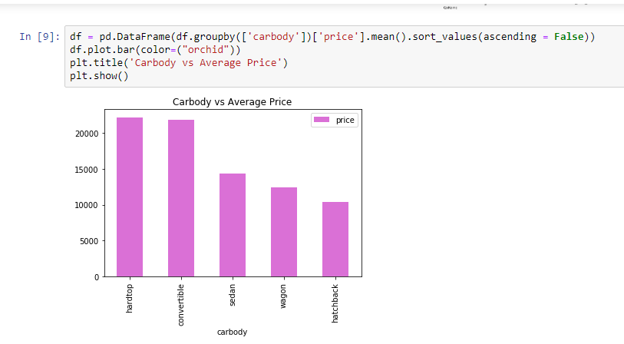
CARBODY VS PRICE

Slide 22
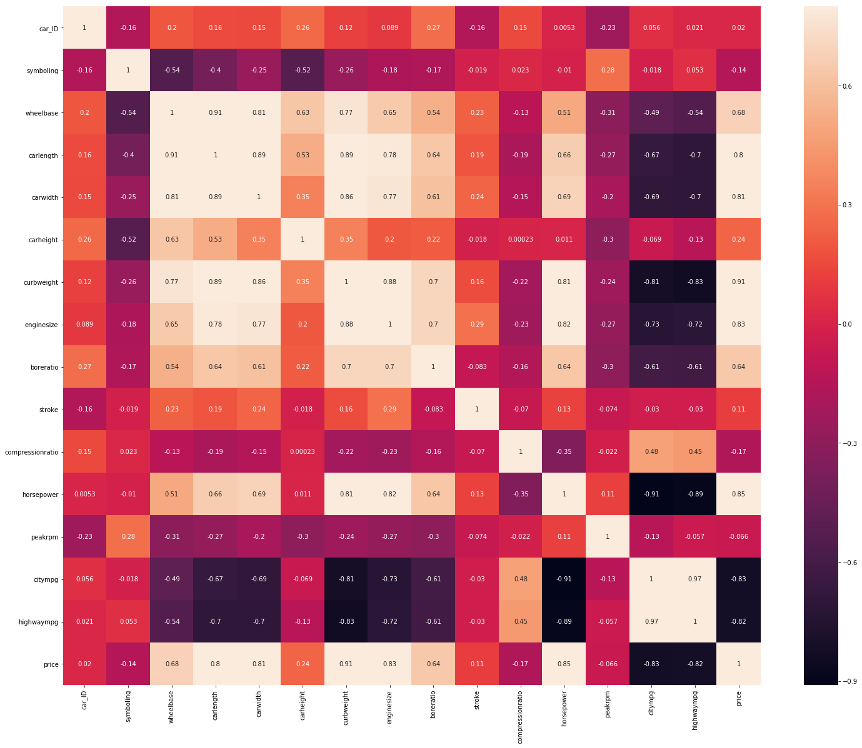
HEAT MAP TO SEE CORELATION

Slide 23
THANKYOU

